Slide 1


In His Name
WELCOME
The End
GOW
About Us
Pseudocode
Article
GOW vs. GA
Hi, Presentation Started ☺

Slide 2


About Article
GOW Algorithm
GOW Algorithm
Pseudocode
Gray Wolf Optimizer
Compare To GA
The End
GOW
About Us
Pseudocode
Article
GOW vs. GA
Mehran.Haaji.Agha.Jaani
s ibollah.Heidari
Habibollah.Heidari
Mehran.Haaji.Agha.Jaani
AI.Mastery.Student
AI.Mastery.Student
Richard Phillips Feynman:
“No one can understand quantum physics,
specially deep understanding…”
Shahab.Danesh.University
Shahab.Danesh.University

Slide 3


The End
GOW
About Us
Pseudocode
Article
GOW vs. GA

Slide 4



The End
GOW
About Us
Pseudocode
Article
GOW vs. GA

Slide 5

The End
GOW
About Us
Pseudocode
Article
GOW vs. GA

Slide 6


Inspiration
apex predators
The End
Article
Pseudocode
GOW
About Us
GOW vs. GA

Slide 7

Inspiration
apex predators
The End
Article
Pseudocode
group contains
5-12 members
GOW
About Us
GOW vs. GA

Slide 8

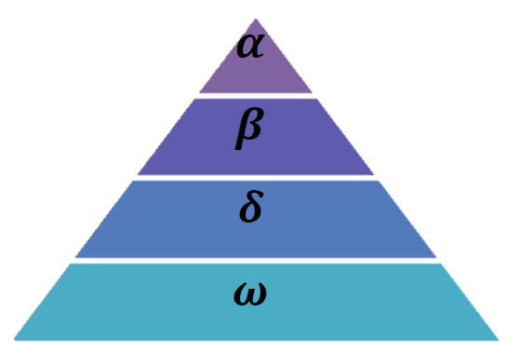
Inspiration
apex predators
group
5-12 members
The End
Article
Pseudocode
GOW
About Us
GOW vs. GA

Slide 9
Inspiration
apex predators
group
5-12 members
The End
Article
Pseudocode
GOW
About Us
GOW vs. GA
Alpha: Leader – Male/Female
Makes Decisions – Makes Orders
Power of thinking

Slide 10
Inspiration
apex predators
group
5-12 members
The End
Article
Pseudocode
GOW
About Us
GOW vs. GA
Beta: Subordinate - Male/Female
Best candidates for Alpha
Reinforces alpha's commands

Slide 11
Inspiration
apex predators
group
5-12 members
The End
Article
Pseudocode
GOW
About Us
GOW vs. GA
Delta: not alpha or beta
Submit to the alpha and beta
Dominate the omega
Scouts, Sentinels, Elders, Hunters, Caretakers

Slide 12
Inspiration
apex predators
group
5-12 members
The End
Article
Pseudocode
GOW
About Us
GOW vs. GA
Omega: Submit to all the other dominant wolves
Last allowed to eat

Slide 13
The End
GOW
About Us
Pseudocode
Article
GOW vs. GA

Slide 14
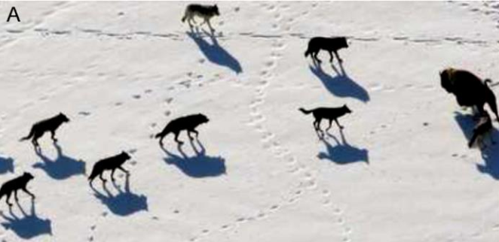



Algorithm Phases
The End
Article
Pseudocode
GOW
About Us
GOW vs. GA
Tracking, chasing, and approaching the prey

Slide 15
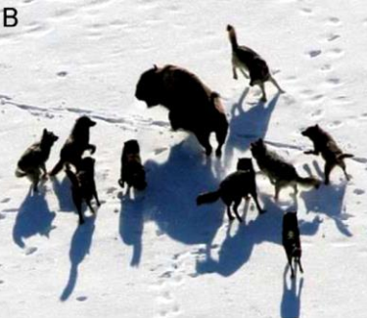
Algorithm Phases
The End
Article
Pseudocode
GOW
About Us
GOW vs. GA
Pursuing, encircling, and harassing the prey until it stops moving

Slide 16
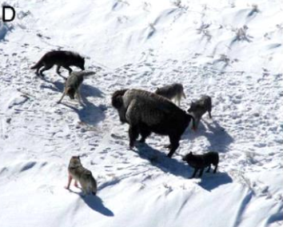
Algorithm Phases
The End
Article
Pseudocode
GOW
About Us
GOW vs. GA
Attack towards the prey

Slide 17
The End
GOW
About Us
Pseudocode
Article
GOW vs. GA

Slide 18
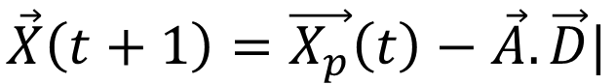
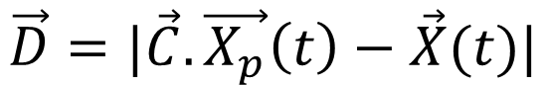
Formulas
Encircling prey
Exploration
$$\vec{D}=|\vec{C}.\vec{X_{p}}\left(t\right)−\vec{X}(t)|$$
prey
Current location
The End
Article
Pseudocode
$$\vec{X}\left(t+1\right)=\vec{X_{p}}\left(t\right)−\vec{A}.\vec{D}|$$
GOW
About Us
GOW vs. GA

Slide 19
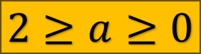
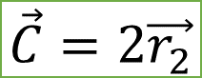
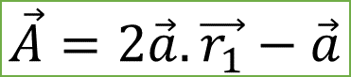
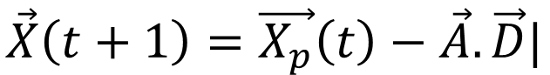
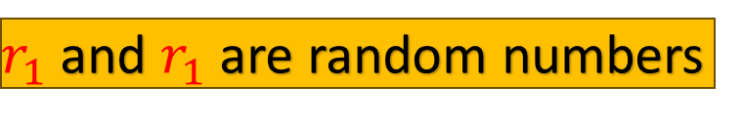
Formulas
Encircling prey
Exploration
$$\vec{D}=|\vec{C}.\vec{X_{p}}\left(t\right)−\vec{X}(t)|$$
prey
Current location
The End
$$\vec{C}=2\vec{r_{2}}$$
Article
Pseudocode
GOW
About Us
GOW vs. GA
$$\vec{X}\left(t+1\right)=\vec{X_{p}}\left(t\right)−\vec{A}.\vec{D}|$$
$$\vec{A}=2\vec{a}.\vec{r_{1}}−\vec{a}$$
$$2≥a≥0$$
$r_{1}$ and $r_{1}$ are random numbers

Slide 20
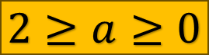


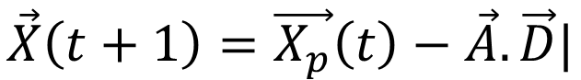
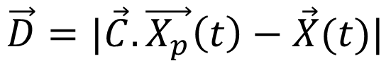

Encircling prey
Formulas
$$\vec{X}\left(t+1\right)=\vec{X_{p}}\left(t\right)−\vec{A}.\vec{D}|$$
$$2≥a≥0$$
prey
The End
GOW
About Us
Pseudocode
Article
GOW vs. GA
$$\vec{A}=2\vec{a}.\vec{r_{1}}−\vec{a}$$
$$\vec{D}=|\vec{C}.\vec{X_{p}}\left(t\right)−\vec{X}(t)|$$
$$\vec{C}=2\vec{r_{2}}$$
$r_{1}$ and $r_{1}$ are random numbers
Current location

Slide 21
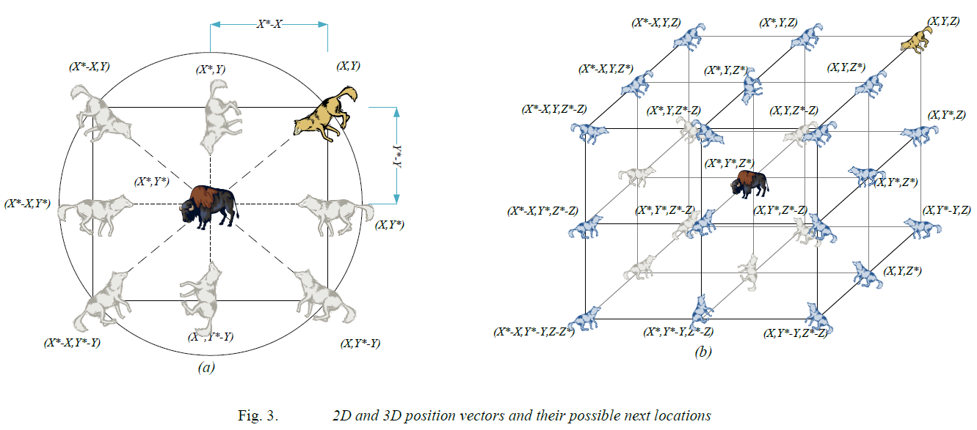
The End
Article
Pseudocode
GOW
About Us
GOW vs. GA

Slide 22
Encircling prey
Formulas
$$\vec{X}\left(t+1\right)=\vec{X_{p}}\left(t\right)−\vec{A}.\vec{D}|$$
$$2≥a≥0$$
prey
The End
GOW
About Us
Pseudocode
Article
GOW vs. GA
$$\vec{A}=2\vec{a}.\vec{r_{1}}−\vec{a}$$
$$\vec{D}=|\vec{C}.\vec{X_{p}}\left(t\right)−\vec{X}(t)|$$
$$\vec{C}=2\vec{r_{2}}$$
$r_{1}$ and $r_{1}$ are random numbers
Current location

Slide 23
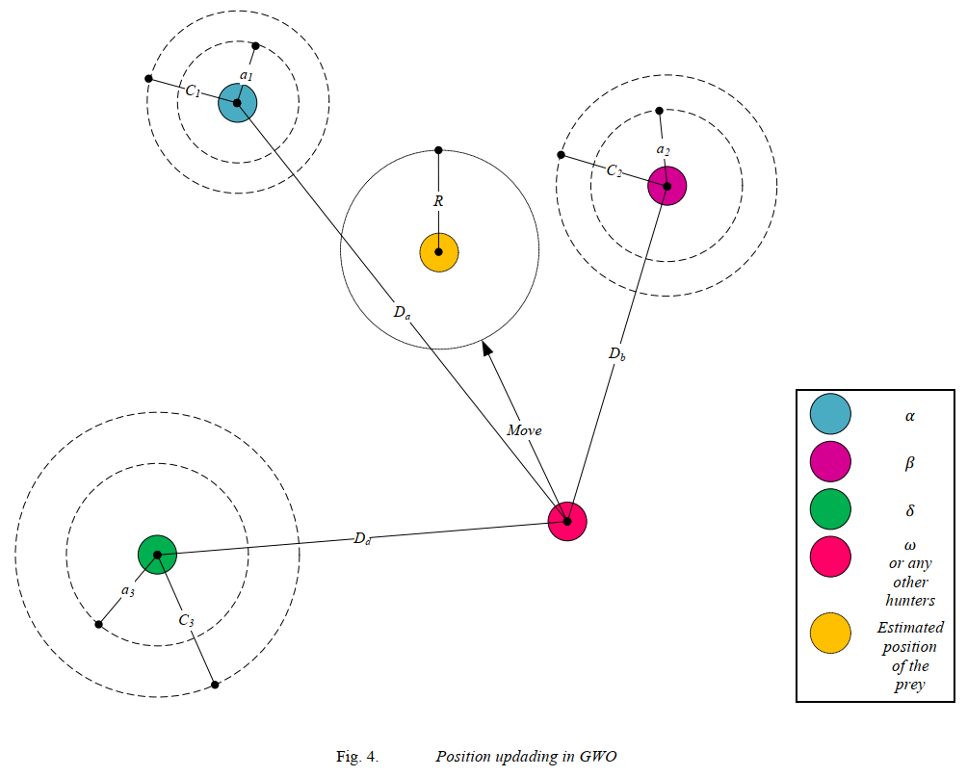
Formulas
Hunting
Exploitation
The End
Article
Pseudocode
GOW
About Us
GOW vs. GA

Slide 24
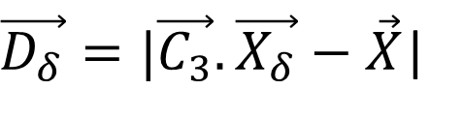
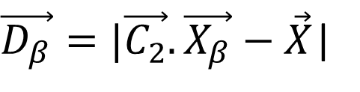
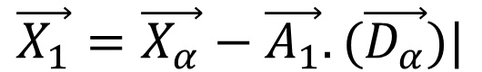
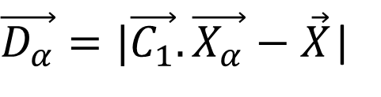
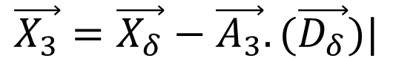
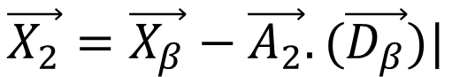
Formulas
Exploitation
Hunting
The End
Article
Pseudocode
GOW
About Us
GOW vs. GA
$\vec{D_{α}}=|\vec{C_{1}}.\vec{X_{α}}−\vec{X}$|
$$\vec{X_{1}}=\vec{X_{α}}−\vec{A_{1}}.(\vec{D_{α}})|$$
$\vec{D_{β}}=|\vec{C_{2}}.\vec{X_{β}}−\vec{X}$|
$$\vec{X_{2}}=\vec{X_{β}}−\vec{A_{2}}.(\vec{D_{β}})|$$
$\vec{D_{δ}}=|\vec{C_{3}}.\vec{X_{δ}}−\vec{X}$|
$$\vec{X_{3}}=\vec{X_{δ}}−\vec{A_{3}}.(\vec{D_{δ}})|$$

Slide 25
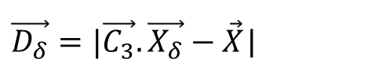
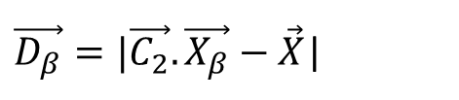
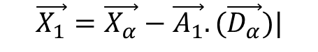
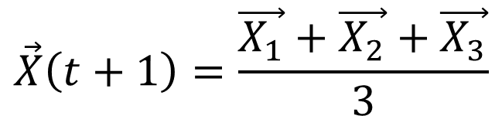
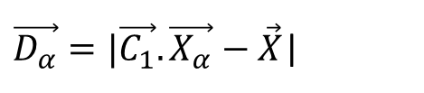
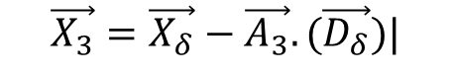
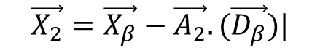
Formulas
Hunting
The End
Article
Pseudocode
GOW
About Us
GOW vs. GA
$\vec{D_{α}}=|\vec{C_{1}}.\vec{X_{α}}−\vec{X}$|
$$\vec{X_{1}}=\vec{X_{α}}−\vec{A_{1}}.(\vec{D_{α}})|$$
$\vec{D_{β}}=|\vec{C_{2}}.\vec{X_{β}}−\vec{X}$|
$$\vec{X_{2}}=\vec{X_{β}}−\vec{A_{2}}.(\vec{D_{β}})|$$
$\vec{D_{δ}}=|\vec{C_{3}}.\vec{X_{δ}}−\vec{X}$|
$$\vec{X_{3}}=\vec{X_{δ}}−\vec{A_{3}}.(\vec{D_{δ}})|$$
$$\vec{X}\left(t+1\right)=\frac{\vec{X_{1}}+\vec{X_{2}}+\vec{X_{3}}}{3}$$

Slide 26
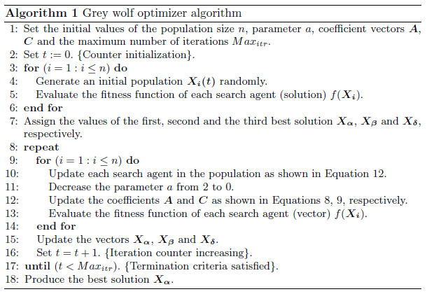
Pseudocode
Parameters initialization
Population initialization
Assign the best three solutions
The End
Article
GOW
About Us
GOW vs. GA
Pseudocode
Solutions updating
Termination criteria
Produce the best solution

Slide 27

Algos Compare
Nature of Algorithm
The End
Article
GOW
About Us
Pseudocode
GOW vs. GA
Natural Selection
Gray Wolves
Natural Evaluation
Hunting
Hierarchy
Wolf Packs

Slide 28




Algos Compare
Nature of Algorithm
Representation of Solutions
The End
Article
GOW
About Us
Pseudocode
GOW vs. GA
Chromosomes
Position of Gray Wolf
In Space

Slide 29




Algos Compare
Nature of Algorithm
Representation of Solutions
The End
Article
GOW
About Us
Pseudocode
GOW vs. GA
Crossover and Mutation
Cross Over
Update the Position
Mutation
Of Gray Wolf

Slide 30




Algos Compare
Nature of Algorithm
Representation of Solutions
The End
Article
GOW
About Us
Pseudocode
GOW vs. GA
Exploration vs. Exploitation
Crossover and Mutation
Genetic
Gray Wolves
Operators
Social hierarchy

Slide 31




Algos Compare
Nature of Algorithm
Representation of Solutions
The End
Article
GOW
About Us
Pseudocode
GOW vs. GA
Convergence Speed
Crossover and Mutation
Exploration vs. Exploitation
Slower
Faster
In Complex Problems

Slide 32




Algos Compare
Nature of Algorithm
Convergence Speed
Representation of Solutions
The End
Article
GOW
About Us
Pseudocode
GOW vs. GA
Applicability
Crossover and Mutation
Exploration vs. Exploitation
Combinatorial Optimization
Optimizaions
Function Optimization
Practically in Engineering
Machine Learning
and Design

Slide 33




Algos Compare
Nature of Algorithm
Convergence Speed
Representation of Solutions
The End
Applicability
Article
GOW
About Us
Pseudocode
GOW vs. GA
Crossover and Mutation
Parameters
Exploration vs. Exploitation
population size
number of wolves
crossover rate
convergence parameters
mutation rate
exploration/exploitation parameters

Slide 34
Algos Compare
Nature of Algorithm
Convergence Speed
Representation of Solutions
The End
Article
GOW
About Us
Pseudocode
Applicability
GOW vs. GA
Crossover and Mutation
Parameters
Exploration vs. Exploitation

Slide 35

Thanks A Lot
For Watching
The End
Article
GOW
About Us
Pseudocode
GOW vs. GA
EX

